Slide 1
Mini Project 2:
Locations API
Matthew John Coffey
LHL Data Science Oct. 25 Cohort

Slide 2
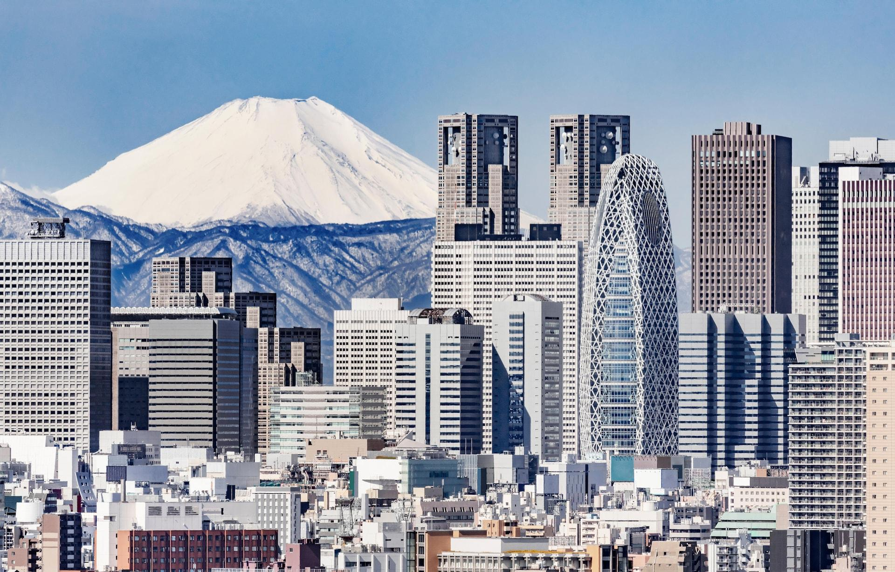

Intent
To send GET requests to both FourSquare and Yelp APIs in order to produce lists of POIs (Points of Interest)
To apply these API calls to locations in Toronto, Ontario, Canada and Ota-ku, Tokyo, Japan
To analyze the results, and find which API has better coverage in each area

Slide 3
Method
Call each API for each location, using the following parameters:
Radius: 1km
Limit Results: 50
Store these results in both SQLite Database / Pandas DataFrame
Visualize results on a map using folium
Find top 10 POIs in each location (based on rating, # of reviews)
Compare results based on:
Mean distance from target
Number of null entries
Number of returned results
Value of information provided (subjective)

Slide 4
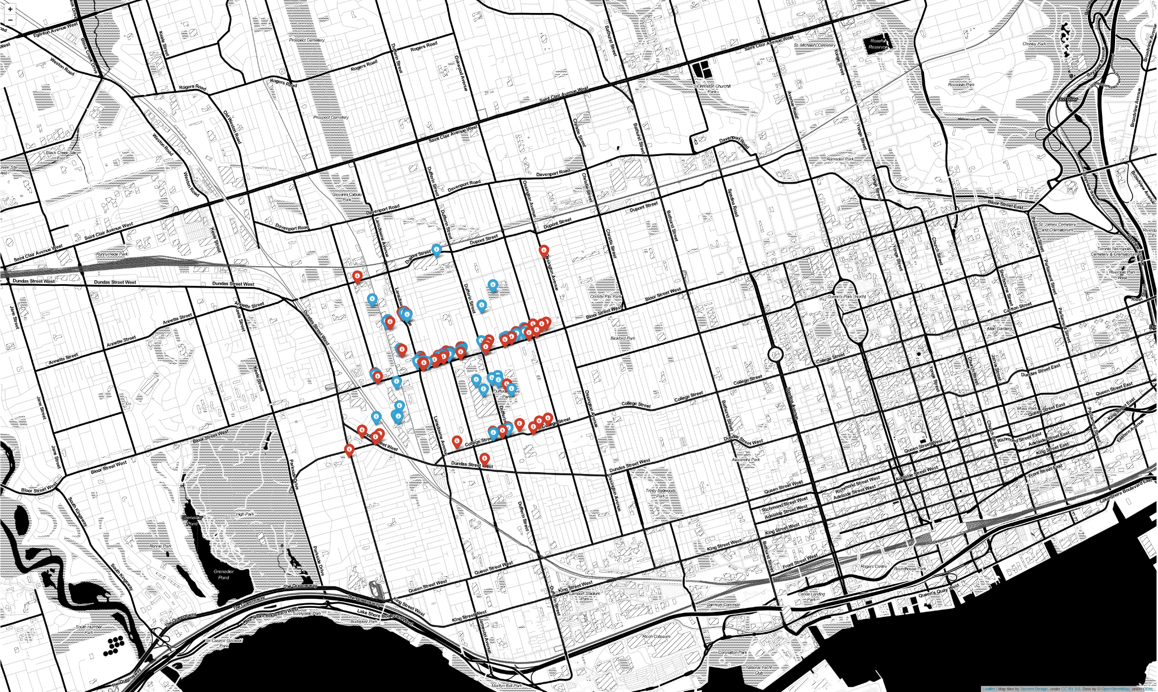
Results - Toronto Map

Slide 5
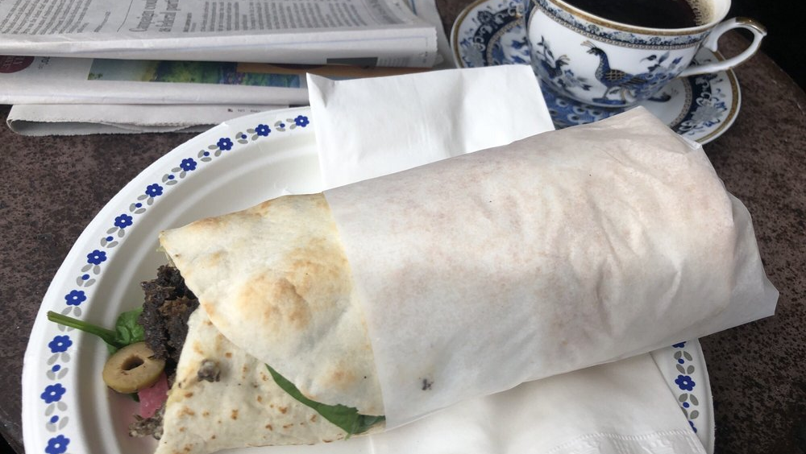
Top 10 POIs - Toronto
Arabesque Middle Eastern Foods (5.0, 27 reviews)
Brewhaha At Bandit Brewery (5.0, 15 reviews)
Dufferin Grove Park (5.0, 14 reviews)
De Floured (5.0, 11 reviews)
Sugo (4.5, 199 reviews)
Takht-e Taboos (4.5, 123 reviews)
Le Baratin (4.5, 108 reviews)
Brock Sandwich (4.5, 101 reviews)
Coo Cafe Bread or Rice (4.5, 84 reviews)
Black Cat Espresso Bar (4.5, 51 reviews)

Slide 6
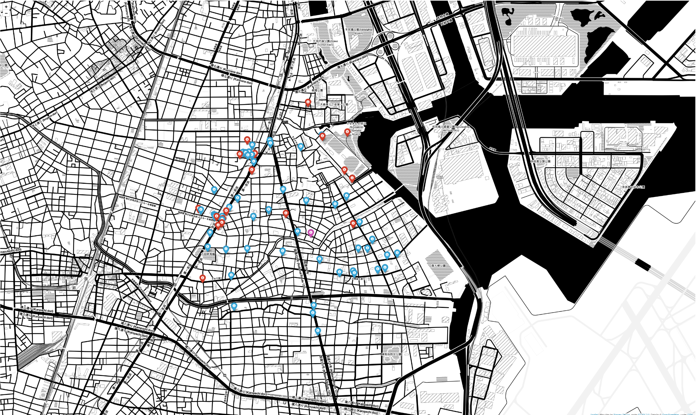
Results - Tokyo Map

Slide 7
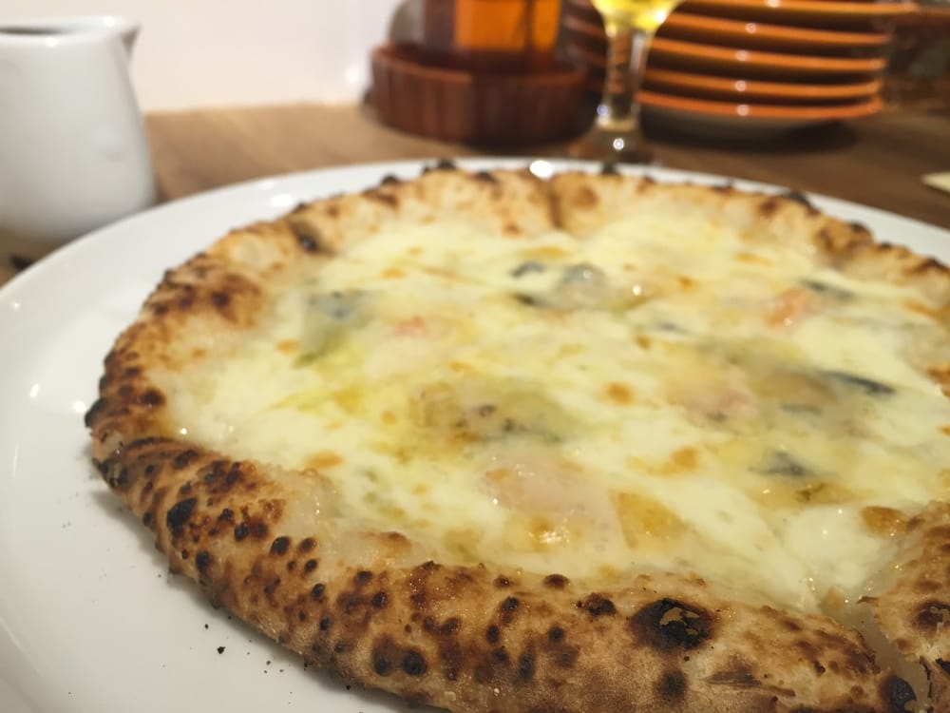
Top 10 POIs - Tokyo
PRINCIPE del sole (5.0, 2 reviews)
Mangan-dō Haneda Airport (5.0, 1 review)
貴船掘公園 (5.0, 1 review)
ジャックニクラスゴルフセンター大森 (5.0, 1 review)
うめ屋敷 (5.0, 1 review)
Oomori furusatonohamabe kouen (4.5, 5 reviews)
Taguishokudō (4.5, 2 reviews)
タケウチ製パン (4.5, 1 review)
Kushikatsu tanaka Oomori (4.5, 1 review)
Ootakuritsukibunehoriryokuchi (4.5, 1 review)

Slide 8
Results - Toronto
Mean distance from target:
Yelp: 623.38m
FourSquare: 507.11m
# of Results:
Both 50
Null Responses:
Yelp: 5 (phone numbers)
FourSquare: 0

Slide 9
Results - Tokyo
Mean distance from target:
Yelp: 766.58m
FourSquare: 696.91m
# of Results:
Yelp: 20
FourSquare: 50
Null Responses:
Yelp: 7 (various)
FourSquare: 0

Slide 10
Conclusion
In both areas, Yelp was able to provide more information, with easier access
Despite Yelp having null entries, the nulls were in categories that FourSquare did not provide
In both areas, FourSquare had a lower mean distance from target
In Tokyo, FourSquare was able to return more results

Slide 11
Areas for Further Research
Increase the sample size (various radiuses, specific search terms)
Include other target areas
Deeper analysis (theoretical foundations)

